Slide 1
Management
PhD in Business Economics
Luis D. Torres, PhD.

Slide 2
Agenda
First part: Behavioural approaches
Behavioural strategy
Organisational culture
Group dynamics
Motivation
Second part: Hands-on
Find a contemporary paper focusing on any of the approaches above and explain it to the class.
Class aim: To critically examine the psychological and sociological foundations of management, tracking how behavioural phenomena scale from individual motivation to group dynamics, and ultimately to organisational culture and strategy.

Slide 3
Introduction
Rational/economic models of the firm vs behavioural approaches.
Powell et al. (2011) argues that strategic management theory lacks adequate psychological grounding and often fails to explain firm heterogeneity.
Merges cognitive and social psychology with strategic management theory and practice
Four core research problems:
How does individual cognition scale to collective behavior?
What are the psychological underpinnings of strategic management theory?
Can behavioral strategy explain complex executive judgments?
Can we improve the psychological architecture of the firm?
Notes:
Porter’s five forces: The five forces are: the threat of new entrants, the bargaining power of suppliers, the bargaining power of buyers, the threat of substitute products or services, and the intensity of rivalry among existing competitors.

Slide 4
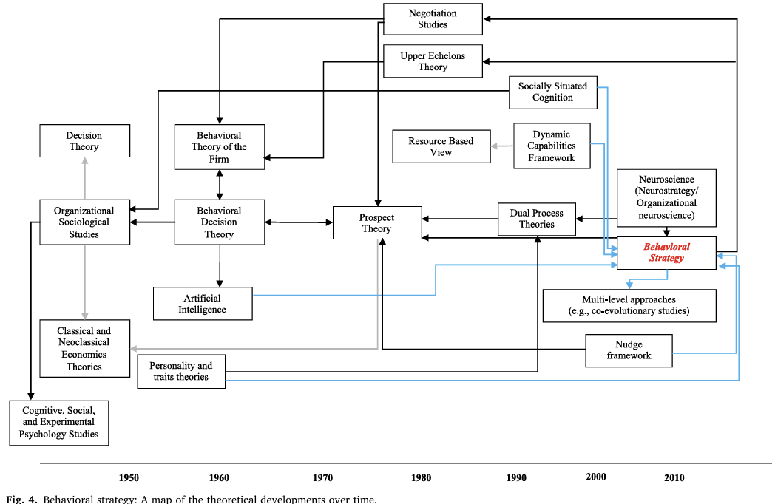
Behavioural strategy
Cristofaro, M., Augier, M., Lovallo, D., Abatecola, G., & Leoni, L. (2024). Behavioral strategy in evolution: A review and conceptual framework. European Management Journal.

Slide 5
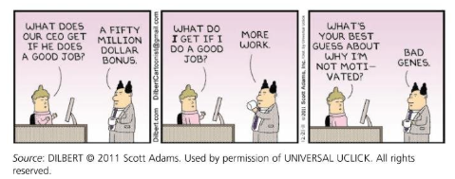
Foundations of Work Motivation
Ambrose (1999)

Slide 6

Foundations of Work Motivation
Intrinsic motivation
Goals come from within and the outcomes satisfy your psychological needs for autonomy, competence, freedom, pleasure, self-realisation.
Extrinsic motivation
Goals involve external gains, such as money, fame, power, or avoiding consequences.
Only the strongest incentive will trigger action

Slide 7


Slide 8




Foundations of Work Motivation
There are many (many) definitions

Slide 9
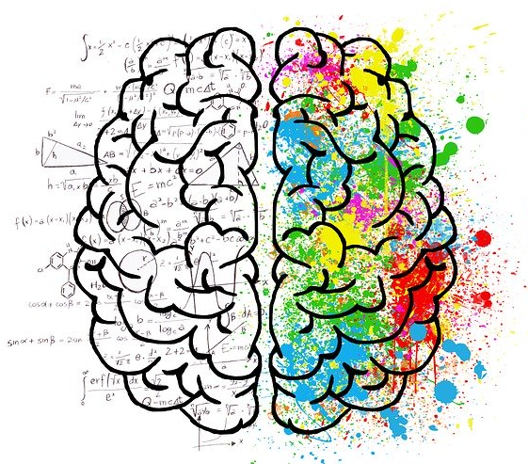
Foundations of Work Motivation
Taylorism: ‘economic person’
Human Relations: ‘social person’

Slide 10
Foundations of Work Motivation
More recent theories include:
Content theories: Identify specify intrinsic and extrinsic motivators. What motivates people?
Maslow’s need hierarchy
Alderfer's ERG theory
Herzberg's Motivation/Hygiene Theory
Process theories: Cognitive theories that look at how we, as individual, “rational actors” make choices with respect to goals. How can people be motivated?
Vroom’s Expectancy theory
Adam’s Equity theory
Locke and Latham’s Goal setting theory

Slide 11
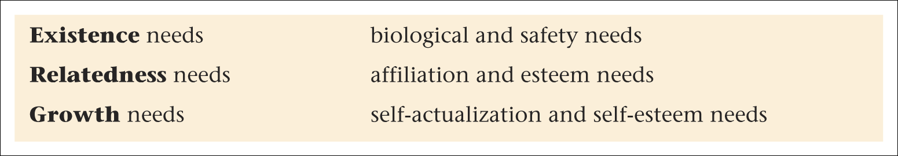
Alderfer’s ERG theory
Similar to Maslow but with 3 levels:
Unlike Maslow people to experience needs simultaneously and when needs are met they become more important not less (e.g., relatedness needs of a team)
Introduces a ‘regression’ principle, we drop back when higher needs frustrated
But, like Maslow, a universal theory with little empirical support

Slide 12
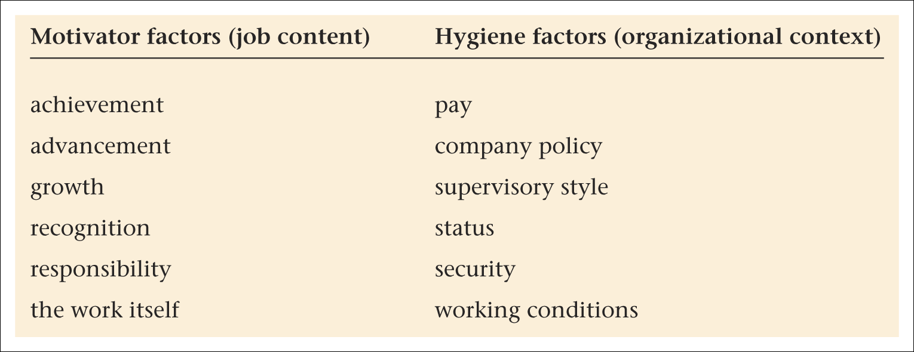
Herzberg’s two factor theory
2 assumptions about the nature of people
need to avoid pain
need to grow
The model proposes that:
Extrinsic ‘hygiene factors’ can prevent job dissatisfaction, but do not contribute to job satisfaction, motivation or performance
Intrinsic ‘motivator’ or ‘growth’ factors can produce high levels of job satisfaction, motivation and performance

Slide 13
Vroom’s Expectancy theory
The theory suggests that although individuals may have different sets of goals, they can be motivated if they believe that:
There is a positive correlation between efforts and performance (E = Expectancy)
Favourable performance will result in a desirable reward (I = Instrumentality),
The reward will satisfy an important need (V = Valence),
M = Σ (E * I * V)

Slide 14
Key challenge: fairness
Internal equity
External competitiveness
Communicate the criteria of why people are being pay differently
Adam’s Equity theory
Person’s outcomes
Person’s inputs
Other’s outcomes
Other’s inputs
= or ≠
Perception
of inequity
Experience
of tension
Motivation
to resolve
Action
to resolve
Equity
restored
You are
paid more
than me
for the
same effort
This is
unfair and
I am
annoyed
I am going
to do
something
about this
Ask for
raise, or
get you to
do all the
hard work
My efforts
& rewards
are now
comparable
to yours

Slide 15
Locke and Latham’s Goal setting theory
Work motivation is influenced by:
Challenging goals (stretch goals)
Specific goals (SMART = specific, measurable, attainable, relevant, and time-bound)
Participation in goal setting
Knowledge of results of past performance (feedback)
Goal-setting the basis for many appraisal systems and has significant empirical support

Slide 16
The Group Level: Moving from Statics to Dynamics
Despite groups being dynamic entities, research has historically focused on group statics and unidirectional cause-effect relationships rather than cross-level dynamics.
Mechanisms of change: Explore how group evolution relies on memory (which induces path dependence) and recursion (circular influence structures/feedback loops)
They categorise group-level constructs into three distinct dynamic profiles based on their capacity for change:
Emergent: rely on individual interactions, beliefs, and attitudes
Cumulative: shared experiences that are captured through a statistical summary of individual traits
Contextual: imposed on the group by external forces
Cronin et al. (2011)

Slide 17
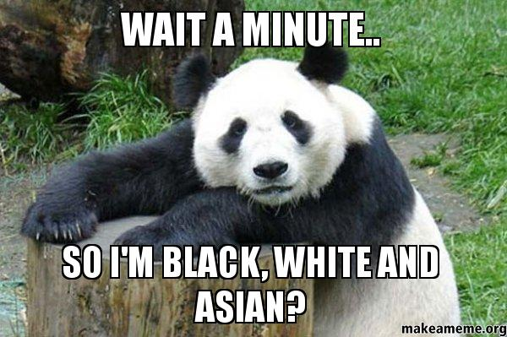
Example of theories
Social identity theory:
Individuals have personal and collective identities
Membership of social groups influences self-perception
Individuals are attracted to groups that enhance self-esteem
Tendency to regard other groups negatively (outgroup)

Slide 18
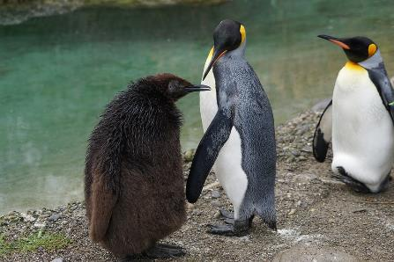
Examples of theories
Tokenism:
Recruiting a small number of people from underrepresented groups in order to give the idea that “we are diverse”
Numerical minorities often experience heightened visibility and scrutiny.
Stereotype treat:
being at risk of confirming, as a self-characteristic, a negative stereotype about one's social group

Slide 19
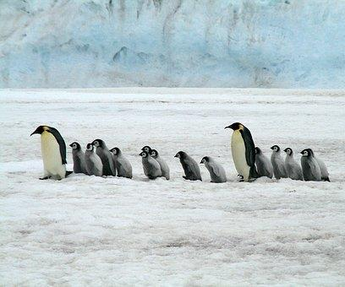
Some examples of research…
Individuals are more attracted to companies whose recruitment documents include statements and images that reflect their own identity group.
A study showed that when organisations use recruitment materials that target sexual minorities, the attraction of study participants weakened among heterosexuals.
Foreign-born potential job candidates are more attracted to organisations that depict international employees in their job ads.
Perkins, L. A., Thomas, K. M., & Taylor, G. A. 2000. Advertising and recruitment: Marketing to minorities. Psychology and Marketing, 17: 235-255.
Lambert, J. R. (2015). The impact of gay-friendly recruitment statements and due process employment on a firm’s attractiveness as an employer. Equality, Diversity and Inclusion: An International Journal, 34, 510–526.
Lambert, J.R., Basuil, D.A., Bell, M.P., & Marquardt, D. J. (2017). Coming to America: Work visas, international diversity, and organizational attractiveness among highly skilled Asian immigrants. The International Journal of Human Resource Management, 0, 1-27.

Slide 20
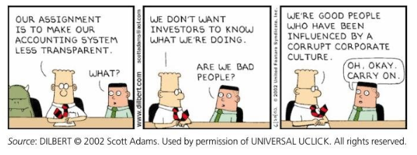
Organisational culture
Organisational or corporate culture is the shared values, beliefs, and norms which influence the way employees think, feel, and act towards others inside and outside the organisation.

Slide 21
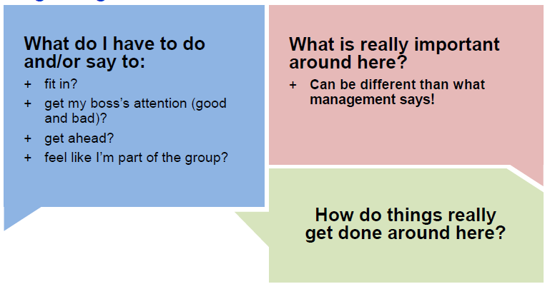

Organisational culture
Think of your own experience:
Would you answer these questions differently in different organisations?

Slide 22
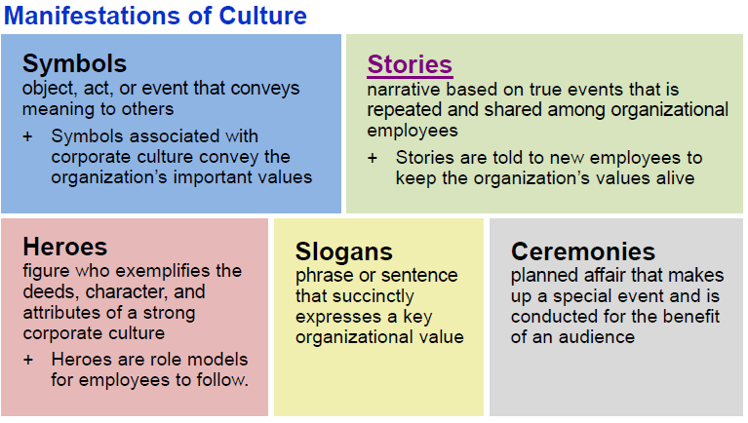

Slide 23
Organisational culture
If an organisational culture is the “internal personality”, can we manage/change it?
Why would we want to change it?
Meek (1988)

Slide 24
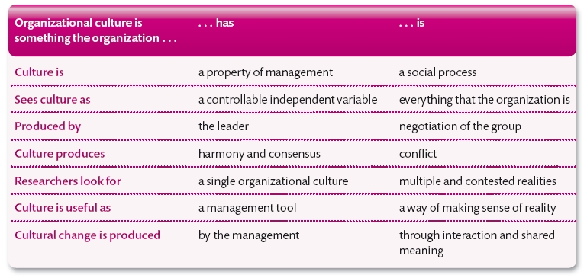
Managerial perspective
Symbolic perspective
Source: Daniel King and Scott Lawley (2016) Organizational Behaviour, 2nd edition, Oxford University Press.

Slide 25
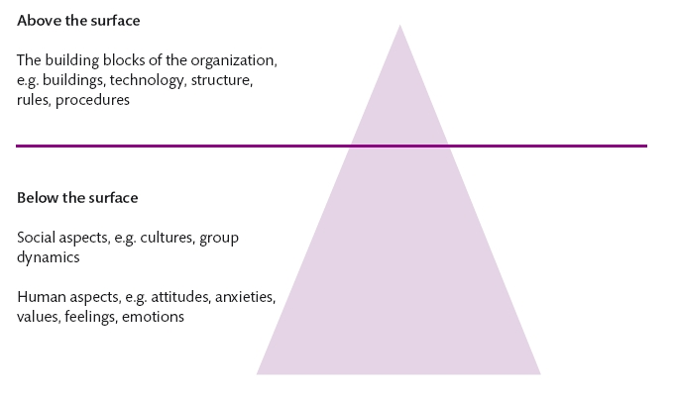
A classic model
Artefacts
Organisational values
Underlying assumptions

Slide 26
Organisational culture
Hatch’s process model:
Manifestation
Realisation
Symbolisation
Interpretation
Hatch's model shifts the theoretical focus from static cultural elements to the dynamic relationships that link them together.
Hatch (1993)

Slide 27
Geert Hofstede is well-known for his work exploring the national and regional cultural influences which affect the behaviour of organisations. He also developed a model for organisational culture:
Organisational effectiveness: Means-oriented vs. goal-oriented
Customer orientation: Internally driven vs. externally driven
Level of control: Easy-going work discipline vs. strict work discipline
Focus: Local vs. professional
Approachability: Open system vs. closed system
Management philosophy: Employee-oriented vs. work-oriented
Source: https://hi.hofstede-insights.com/organisational-culture

Slide 28
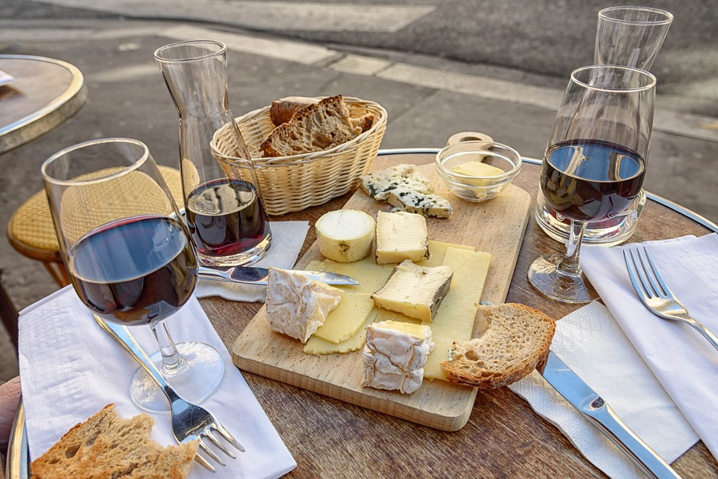
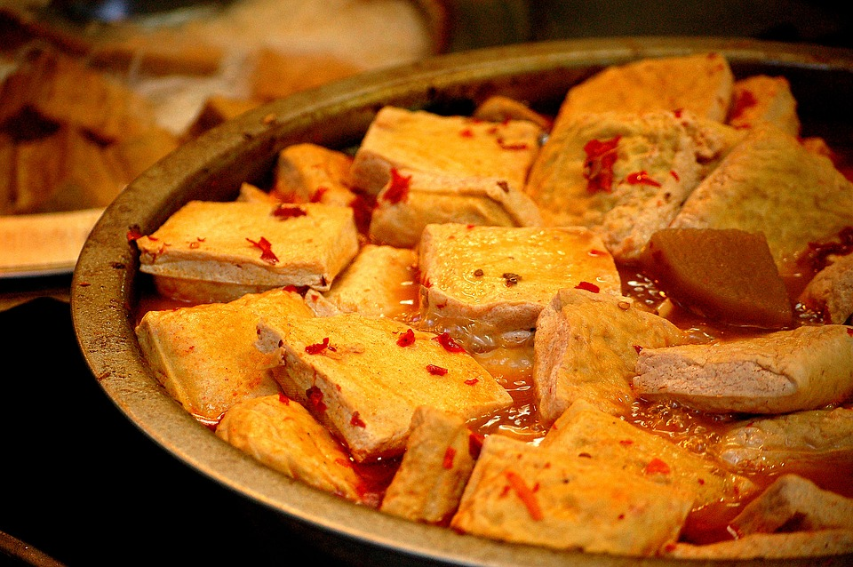
Do not forget that this is embedded in a national culture.
Cheese
Stinky tofu

Slide 29
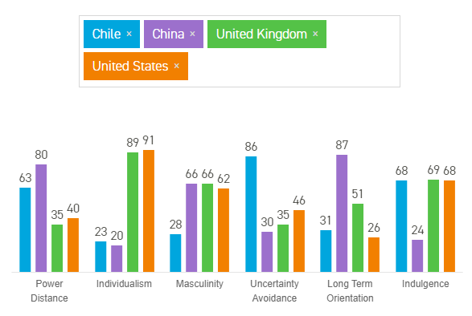
Hofstede’s model
A detailed explanation of the dimensions can e found here: https://geerthofstede.com/culture-geert-hofstede-gert-jan-hofstede/6d-model-of-national-culture/
https://www.hofstede-insights.com/country-comparison/

Slide 30
Research Workshop
The Scaling Problem: how does individual cognition scale to collective behaviour?
Address the crucial problem identified by Powell et al.:
Strategy often incorrectly assumes that a firm or corporation simply shares the psychology of an individual.
Sketch a high-level research proposal: Working as a group, you must:
choose one individual-level behavioural concept (e.g., a motivational bias or cognitive heuristic)
design a study that traces its impact through group dynamics (using Cronin's emergent/cumulative frameworks) up to the level of organisational strategy or culture.

